Slide 1




1
3
Crop Analysis on UAV Images
Student: Pham Gia Phuc
Supervisor: Dr. Tran Giang Son

Slide 2

CONTENTS
INTRODUCTION
RESULTS AND DISCUSSION
BACKGROUND
CONCLUSIONS
MATERIALS AND METHOD
Page 2

Slide 3
Introduction
Agriculture
the activity of raising plants and animals
important development in the rise of sedentary human civilization
growing crop, herding and breeding wild animal
Precision Agriculture
a method for managing farms
uses information technology (IT)
ensure crop and soil receive exact nutrients require
achieving the highest levels of profitability, sustainability, and environmental protection
Page 3
Notes:
Agriculture or farming is the practice of cultivating plants and livestock.^{[1]} Agriculture was the key development in the rise of sedentary human civilization, whereby farming of domesticated species created food surpluses that enabled people to live in cities
the practice of cultivating plants and livestock
key development in the rise of sedentary human civilization
- ensure crops and soil receive exactly what they need for optimum health and productivity
- ensure rofitability, sustainability and protection of the environment

Slide 4
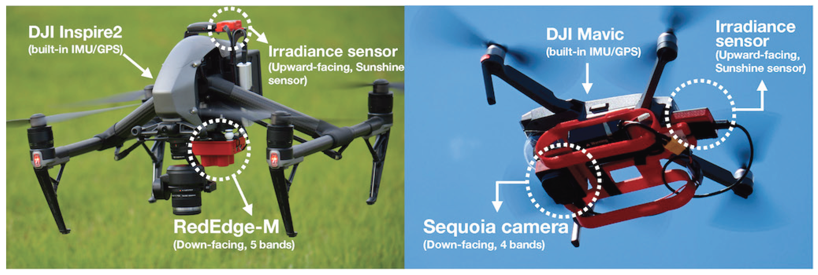
Introduction
Unmanned Aerial Vehicle (UAV)
an aircraft
no human pilot
no crew
no passengers
UAV in Agriculture
large area from above
high spatial/spectral resolution
available all time
not sensitive to clouds
accurate position
difficult areas accessibility
provide more information
Page 4
a component of an Unmanned Aircraft System (UAS)
a ground-based controller
system of communications with the UAV
Notes:
a component of an Unmanned Aircraft System (UAS) which includes adding a ground-based controller and a system of communications with the UAV
By flying above, uav can cover large area

Slide 5
Introduction
Internship Objective
Study precision agriculture
Research in semantic segmentation
Create a deep learning model – uses multispectral images for crop/weed mapping
Implemented model – help scientists and farmers choose which algorithms to use.
accurately analyzing different crop/weed locations
Page 5
Notes:
Develop a deep learning model for crop/Weed mapping that utilizes multispectral pictures
Implemented model – able to assist scientists and farmers in deciding which algorithms to employ

Slide 6
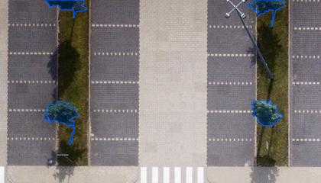
Background
Semantic segmentation
Precision Agriculture
A Computer Vision task – specific regions of an image will be labelled
Aim to assign a class to each pixel
Corresponds to the concept being represented
Page 6
Autonomous vehicles
BioMedical Image Diagnosis
Geo Sensing
Notes:
Will be added with images after the “NOTE” disappear with animation
only considers the category of each pixel, not instances of the same class
does not automatically differentiate two objects of the same category in the input image as independent ones

Slide 7
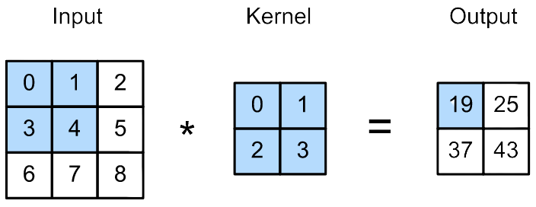
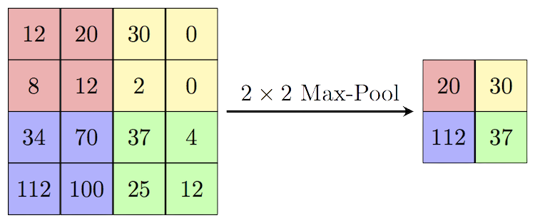
Background
Convolution operation
process of transforming an image
applying a kernel
-> feature map
Figure: Convolution operation
Max pooling operation
make the feature map smaller
eliminate unnecessary information
reduce dimension
Page 7
arrays could be of different sizes
the dimensions should be the same for both arrays
Notes:
arrays could be of different sizes
the dimensions should be the same for both arrays

Slide 8
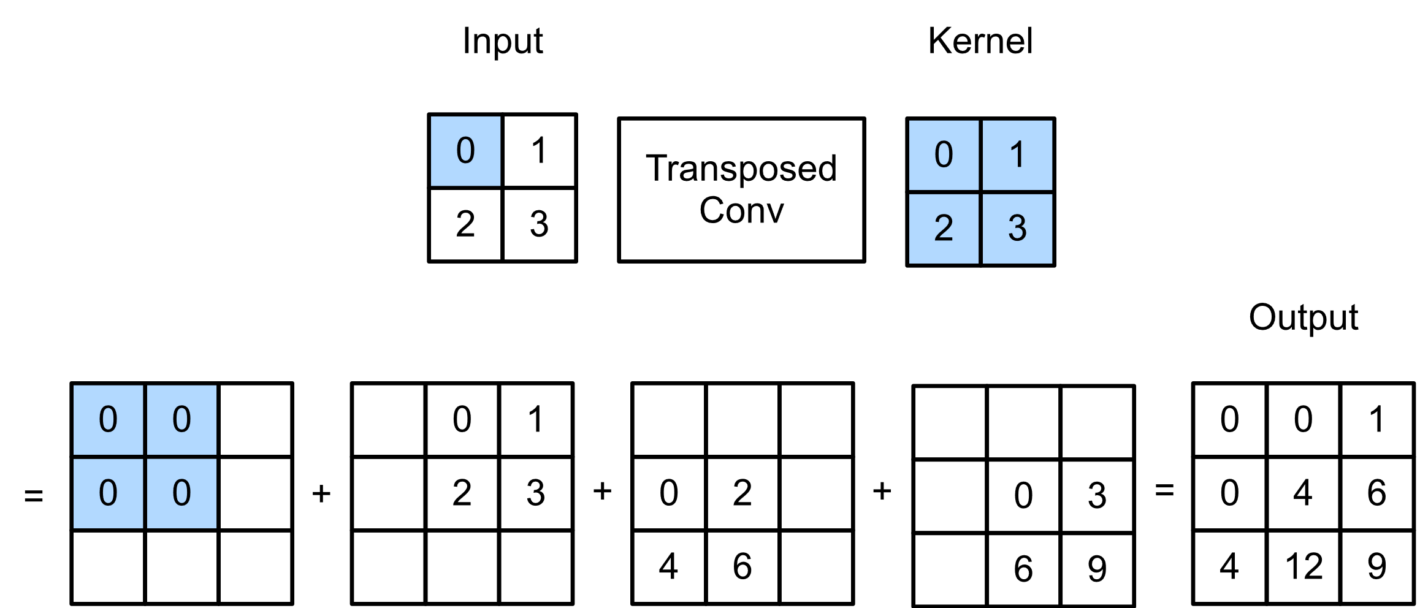
Background
Transposed Convolution
method for carrying out up-sampling
the precise revert of a traditional convolution
input - low quality images
output - high quality images
Page 8
Notes:
maximum pixel value from each 2x2 block of the input feature map is chosen to create a pooled feature map
https://d2l.ai/chapter_computer-vision/transposed-conv.html

Slide 9
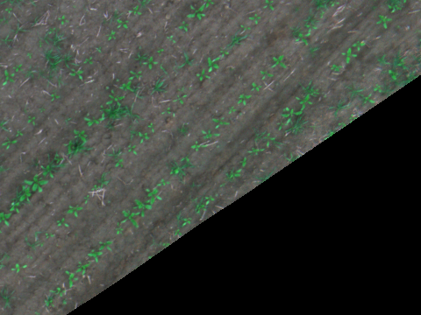

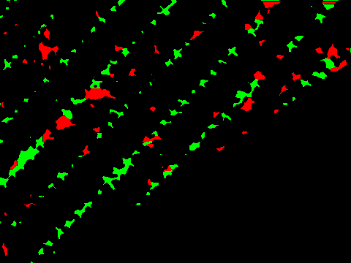
Materials and Methods
Data preparation
Data used filtered from original 2018 Weed Map Dataset:
Public in ASL Datasets
Divided into 129 directories and 18746 png picture files
Only RGB images, mask and groundtruth (green: crop; weed: red)
Stored into 3 directories, 1668 png files
RGB image
mask image
groundtruth image
Page 9

Slide 10
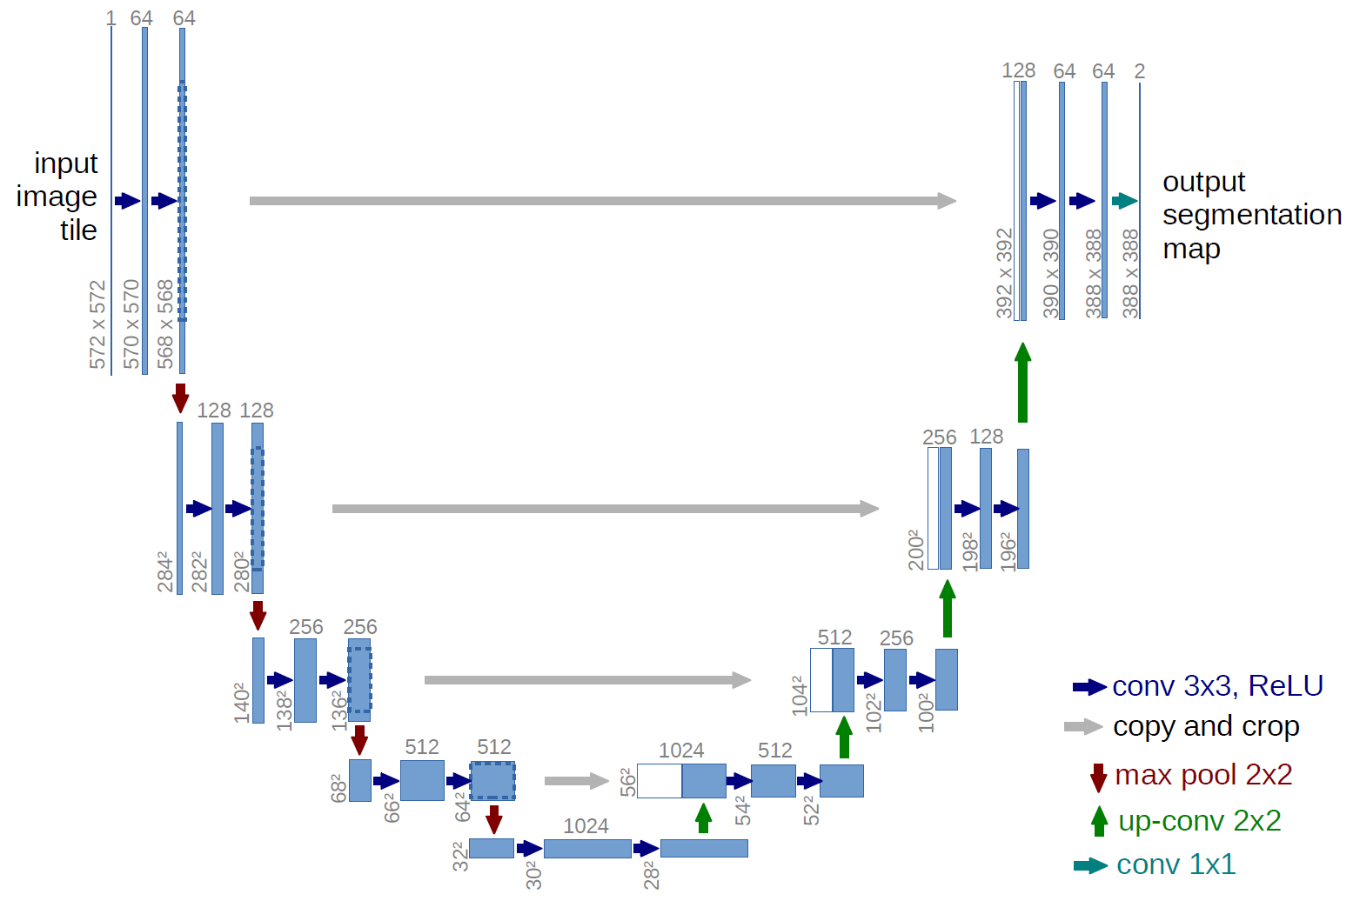
Materials and Methods
UNet model
first introduced for biological image segmentation
expanded and modified architecture
pictures enables for working with little training
fully convolutional neural networks-based
Page 10
Notes:
tweaked and extended architecture
allows operating with less training photos
more accurate segmentation
based on fully convolutional neural networks

Slide 11
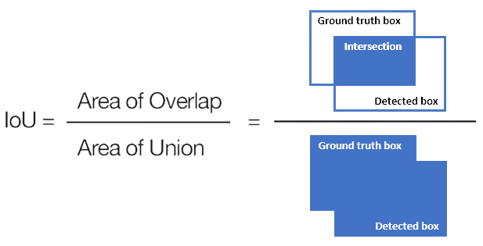
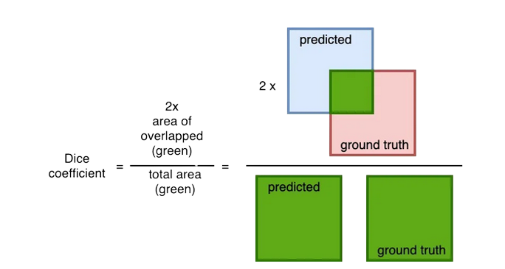
Results and Discussion
Evaluation metrics
Intersection over Union (Jaccard index)
an evaluation metric
measure the accuracy of an object detector
Dice Coefficient (F1 Score)
similar to the IoU
range from 0–1 (0–100%)
0 - no overlap
1 - perfectly overlap
Page 11
Notes:
IoU is the area of overlap between the predicted segmentation and the ground truth divided by the area of union between the predicted segmentation and the ground truth.
Dice Coefficient is 2 * the Area of Overlap divided by the total number of pixels in both images

Slide 12
Results and Discussion
Training configuration
Parameter | Value
Training set | 90%
Validating set | 10%
Epochs | 100
Steps per epoch | 10
Batch size | 32
Early stopping | After 10 epochs
Parameter | Value
Reduce LR on Plateau | After 5 epochs
Learning rate | 10⁻³
Min learning rate | 10⁻⁵
Optimizer | Adam
Metrics | IoU
 | Dice coefficient
Page 12

Slide 13
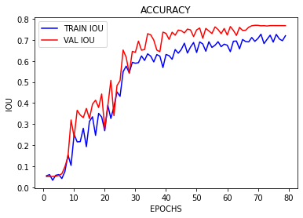
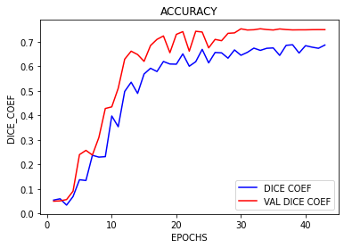
Results and Discussion
Quantitative evaluation
IoU score
0.7679
76.79%
Dice coefficient score
0.7495
74.95%
Page 13

Slide 14
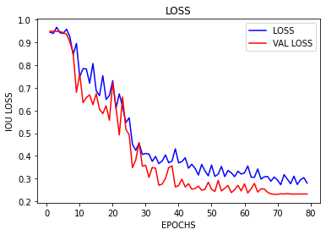
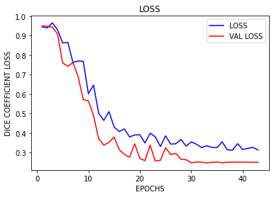
Results and Discussion
Loss
IoU loss
0.2863
Dice coefficient loss
0.2505
Page 14

Slide 15
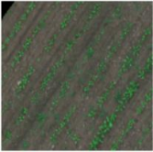
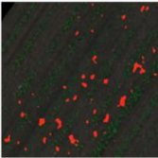
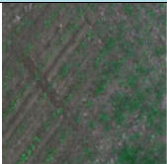
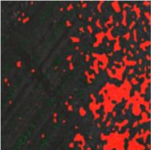
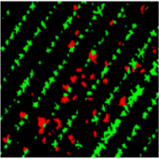
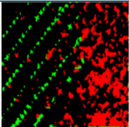
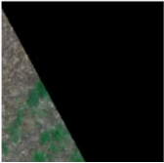
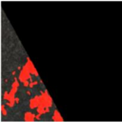
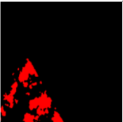
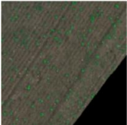
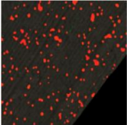
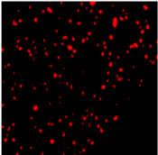
Results and Discussion
Qualitative evaluation
RGB image
predicted mask
groundtruth
IoU (%)
Analyze
62.17%
More complicated details
86.91%
Less complicated details
Page 15
Notes:
more analyse

Slide 16
Results and Discussion
Comparison with existing works
Model | Device | Mean IoU
This work | Tesla K80 | 76.79
FCN-Alexnet by Jizhong et al (2020) [6] | GTX 1060 | 70.50
VGGNet-FCN by Simonyan et al (2015) [25] | GTX 1060 | 72.80
GoogLeNet-FCN by Szegedy et al (2015) [26] | GTX 1060 | 71.30
ResNet-FCN by He et al (2016) [13] | GTX 1080 TI | 77.20
Page 16
Notes:
Reference in new slide
Why

Slide 17
Conclusion
Complete the internship objective
Studied semantic segmentation
Research and implemented weed segmentation on UAV images
UNet segmentation model achieve ≈76% IoU and ≈74% Dice Coefficient
Future works
Improve model performance
Implement with more datasets
Try other deep learning models
Implement both crop/weed segmentation
Page 17

Slide 18

Thank You For Your Attention!
Please, keep this slide for attribution.

